Slide 1
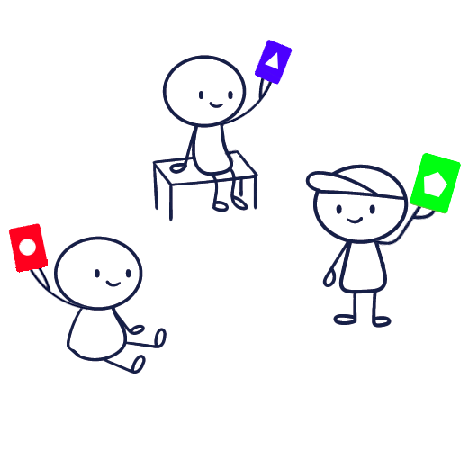
Explanation Kwizpel multiple-choice question:
Read the question aloud and ask the class to think.
Explain that when the timer runs out, the class must hold up their chosen color!
Let the timer run.
... The class holds up their cards...
Ask a student why they chose an answer.
Show the correct answer via the PP.

Slide 2
What is 38 times 42?
0
0
5
4
3
2
1
1596
1602
1608
1612
20
10

Slide 3
What is 38 times 42?
To calculate 38 times 42:
First: 40 * 40 = 1600
Add 2 * 40 => 1600 + 80 = 1680 (= 42 * 40)
Subtract 2 * 42 => 1680 – 84 = 1596 ( = 38 * 42)

Slide 4
Explanation of the right/wrong question:
Read the question aloud and ask the class to think.
Explain that when the timer runs out, the class must hold up their chosen color!
Let the timer run.
... The class holds up their cards...
Ask a student why they chose which answer.
Show the correct answer via the PP.

Slide 5
Statement: On the Moon, there is more gravity than on Earth.
0
0
5
4
3
2
1
True
False
5

Slide 6
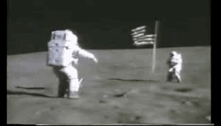
Statement: There is more gravity on the Moon than on Earth.
Wrong: The gravity on the Moon is lower than the gravity on the Earth.

Slide 7
Explanation of the Kwizpel scale question:
Read the question aloud and invite the class to ponder their opinions.
Explain that when the timer runs out, the class must hold up a color that matches their opinion.
Let the timer run.
... The class holds up their cards...
Ask a student why they chose which answer.

Slide 8
Statement: Sweets should be banned in school.
Hand Down
Strongly disagree
Disagree
Neutral
Agree
Totally agree
0
0
5
4
3
2
1
45
15
30
Notes:
Helemaal mee oneens - Mee oneens - Neutraal - Mee eens - Helemaal mee eens
Zeer onwaarschijnlijk - Onwaarschijnlijk - Neutraal - Waarschijnlijk - Zeer waarschijnlijk
Helemaal niet tevreden - Niet tevreden - Neutraal - Tevreden - Helemaal tevreden
Zeer onbelangrijk - Onbelangrijk - Neutraal - Belangrijk - Zeer belangrijk

Slide 9
Empty slide: make your own question.
0
0
5
4
3
2
1
Answer 1
Answer 2
Answer 3
Answer 4
20
10

Slide 10
Timers:
0
0
0
0
5
4
3
2
1
45
15
20
10
10
30
Count down timer 5 seconds
20 seconds
30 seconds
60 seconds

